Slide 1

USER
ENGAGEMENT
ANALYSIS
FOR
RESTAURANT BUSINESS

Slide 2
ABOUT YELP
Yelp is a web and mobile platform that functions as a crowd-sourced local business review site. Users can submit reviews, photos, and tips about businesses, while also browsing information and ratings left by others.

Slide 3
AGENDA
Problem Statement
Research Objectives
Hypothesis
Data Overview
Analytics and Findings
Recommendations

Slide 4

Problem Statement
In a competitive market like the restaurant industry, understanding the factors that influence business success is crucial for stakeholders. Utilizing the Yelp dataset, this project aims to investigate the relationship between user engagement (reviews, tips, and check-ins) and business success metrics (review count, ratings) for restaurants.

Slide 5





Research Objectives
Quantify the correlation between user engagement (reviews, tips, check-ins) and review count/average star rating.
Analyze the impact of sentiment on review count and average star rating.
Time Trends in User Engagement

Slide 6
Hypothesis
Higher levels of user engagement (more reviews, tips, and check-ins) correlate with higher review counts and ratings for restaurants.
Positive sentiment expressed in reviews and tips contributes to higher overall ratings and review counts for restaurants.
Consistent engagement over time is positively associated with sustained business success for restaurants.

Slide 7
Data Overview
This dataset is a subset of Yelp and has information about businesses across 8 metropolitan areas in the USA and Canada.
The original data is shared by Yelp as JSON files.
The five JSON files are business, review, user, tip and checkin.
The JSON files are stored in the database for easy retrieval of data.

Slide 8
Analysis and Finding
Out of 150k businesses, 35k are restaurants business and are open.
Table showing distribution of business success metrics (review count and average rating):
avg(review_count) | 104.097789
min(review_count) | 5.000000
max(review_count) | 7568.000000
median_review_count | 15.000000
avg(stars) | 3.523969
min(stars) | 1.000000
max(stars) | 5.000000
median_star_rating | 3.500000

Slide 9
Highest Rating
Highest Review Count
name | avg_rating
ā café | 5.0
two birds cafe | 5.0
the brewers cabinet production | 5.0
taqueria la cañada | 5.0
la bamba | 5.0
la 5th av tacos | 5.0
el sabor mexican and chinese food | 5.0
eat.drink.Om...YOGA CAFE | 5.0
d4 Tabletop Gaming Cafe | 5.0
cabbage vegetarian cafe | 5.0
name | review_counts
McDonald's | 16490
Chipotle Mexican Grill | 9071
Taco Bell | 8017
Chick-fil-A | 7687
First Watch | 6761
Panera Bread | 6613
Buffalo Wild Wings | 6483
Domino's Pizza | 6091
Wendy's | 5930
Chili's | 5744
Higher ratings do no guarantee a higher review count, or vice versa.
Success of Restaurants is not solely determined by ratings or review counts.
Review count reflects user engagement but not necessarily overall customer satisfaction or business performance.

Slide 10
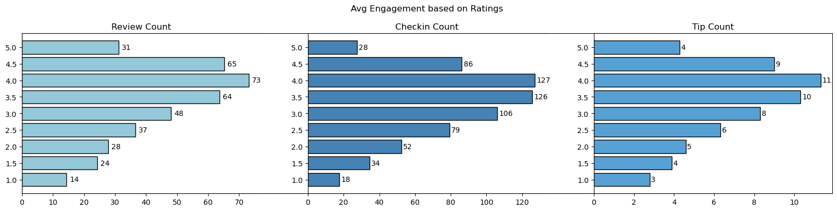
Do restaurants with higher engagement tend to have higher ratings?
Data shows a general increase in average review, check-in, and tip counts as ratings improve from 1 to 4 stars.
Restaurants rated 4 stars exhibit the highest engagement and shows a downward trend for rating above 4.
The drop in engagement at 5.0 stars might suggest either a saturation point where fewer customers feel compelled to add their reviews, or a selectivity where only a small, satisfied audience frequents these establishments.

Slide 11
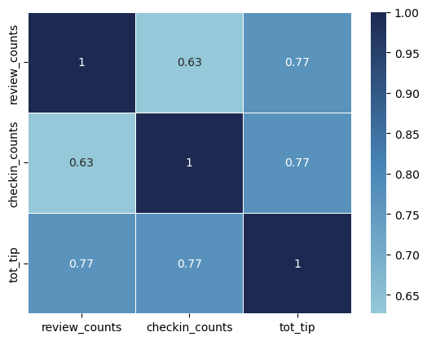
Is their any correlation between reviews , tips and checkins in the business?
These correlations suggest that user engagement across different platforms (reviews, tips, and check-ins) is interlinked; higher activity in one area tends to be associated with higher activity in others.
Businesses should focus on strategies that boost all types of user engagement, as increases in one type of engagement are likely to drive increases in others, enhancing overall visibility and interaction with customers

Slide 12
Is there a difference in user engagement(reviews, tips,
checkins) between low rated and high rated business?
Data indicates a clear correlation between higher ratings and increased user engagement across reviews, tips, and check-ins.
This pattern underscores the importance of maintaining high service and quality standards, as these appear to drive more reviews, check-ins, and tips, which are critical metrics of customer engagement and satisfaction.
 | review_counts | checkin_counts | tot_tip
category
high_rated | 74.299375 | 115.681302 | 10.065121
low_rated | 52.390839 | 106.919161 | 8.039871

Slide 13
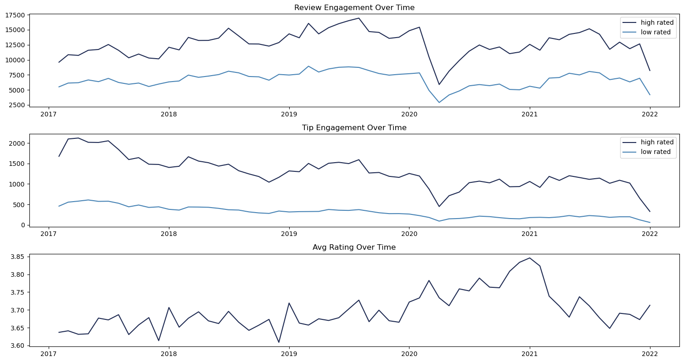
Are there any patterns in user engagement over time for successful businesses compared to less successful ones?
Successful businesses, particularly those with higher ratings (above 3.5), exhibit consistent and possibly increasing user engagement over time.
High rated restaurants maintain a steady or growing level of user engagement over time, reflecting ongoing customer interest and satisfaction.

Slide 14
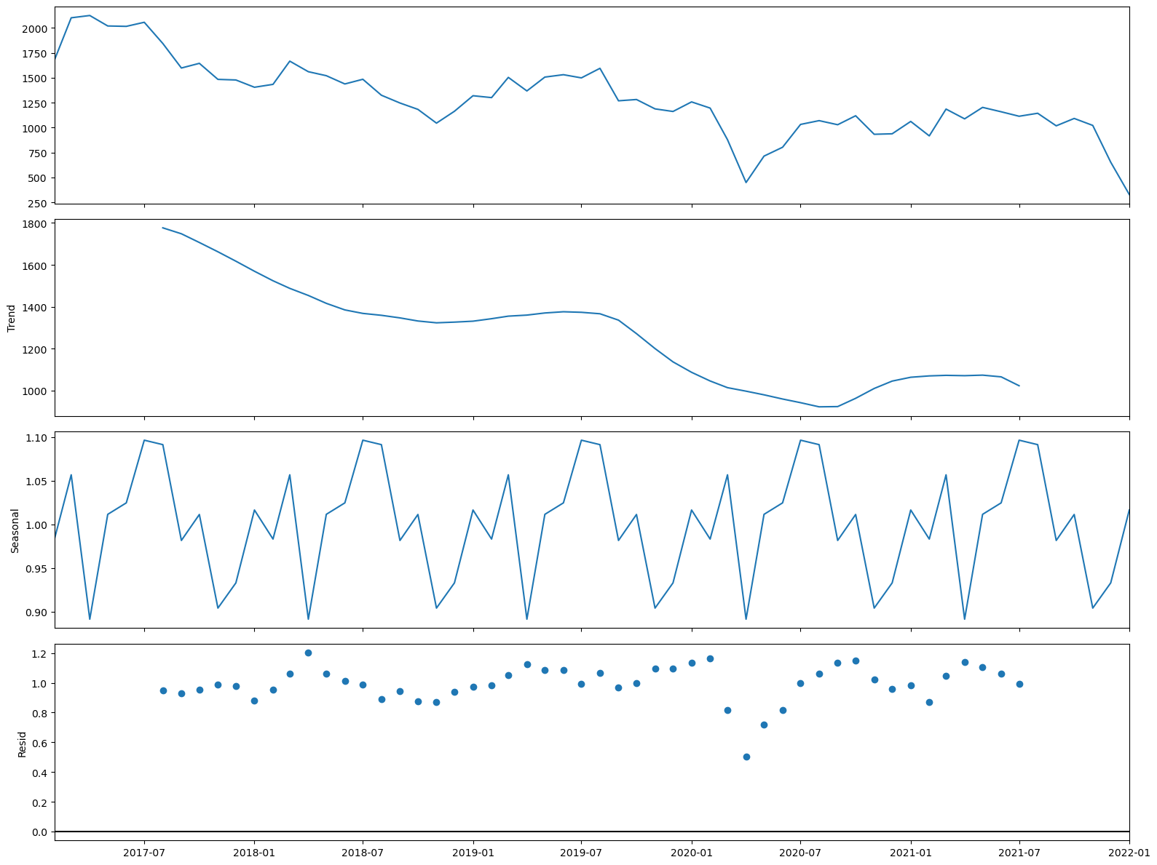
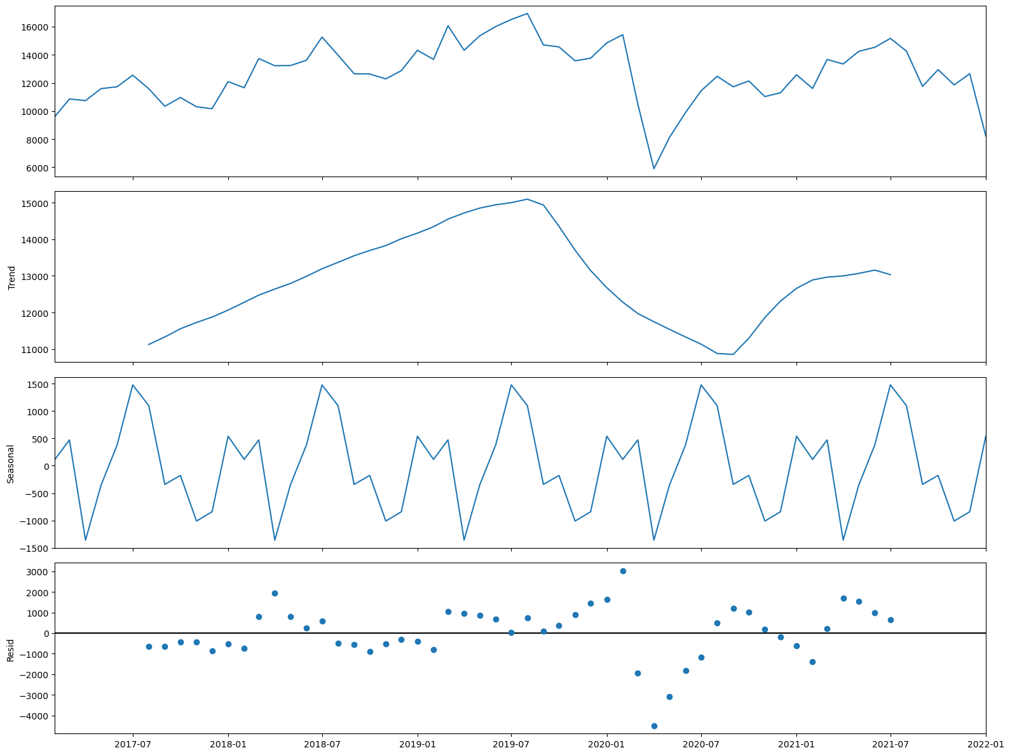
Are there any seasonal trends in the user engagement for restaurants?
Tip Count
Review Count

Slide 15
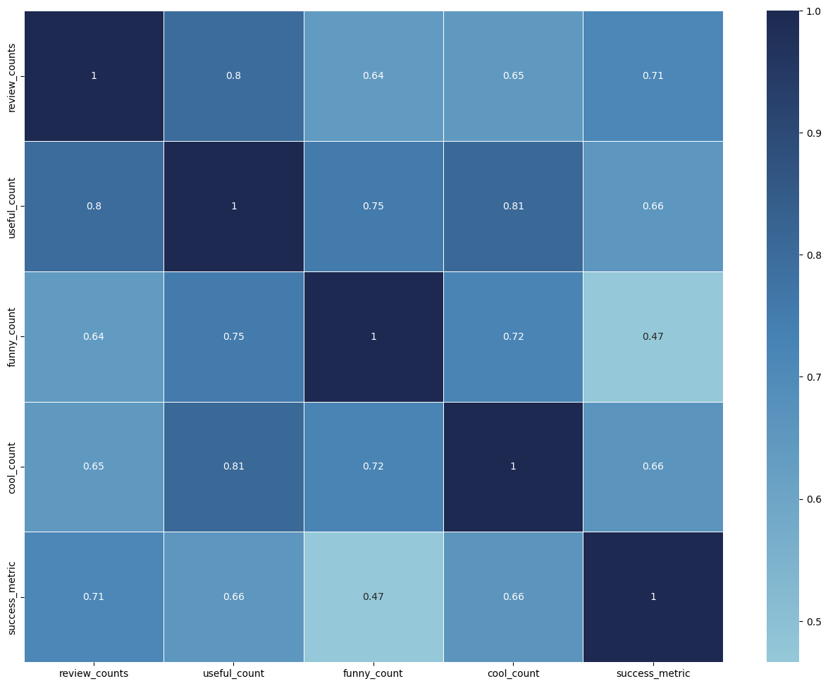
How does the sentiment of reviews and tips (useful, funny, cool) correlate with the success metric of the restaurants?
"useful," "funny," and "cool" are attributes associated with user reviews. They represent the feedback provided by users about the usefulness, humor, or coolness of a particular review.
Higher counts of useful, funny, and cool reviews suggest greater user engagement and satisfaction, which are key factors contributing to a restaurant's success.

Slide 16
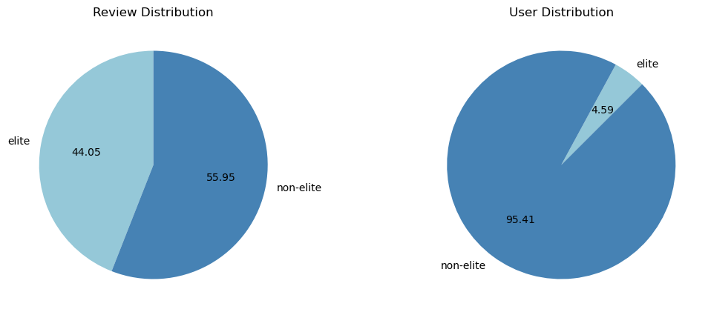
Is there any difference in the engagement of elite users and non-elite users?
Elite users are individuals who have been recognized and awarded the "Elite" status by Yelp for their active and high-quality contributions.
Elite users, despite being significantly fewer in number, contribute a substantial proportion of the total review count compared to non-elite users.
Establishing a positive relationship with elite users can lead to repeat visits and loyalty, as they are more likely to continue supporting businesses they have had good experiences with.

Slide 17
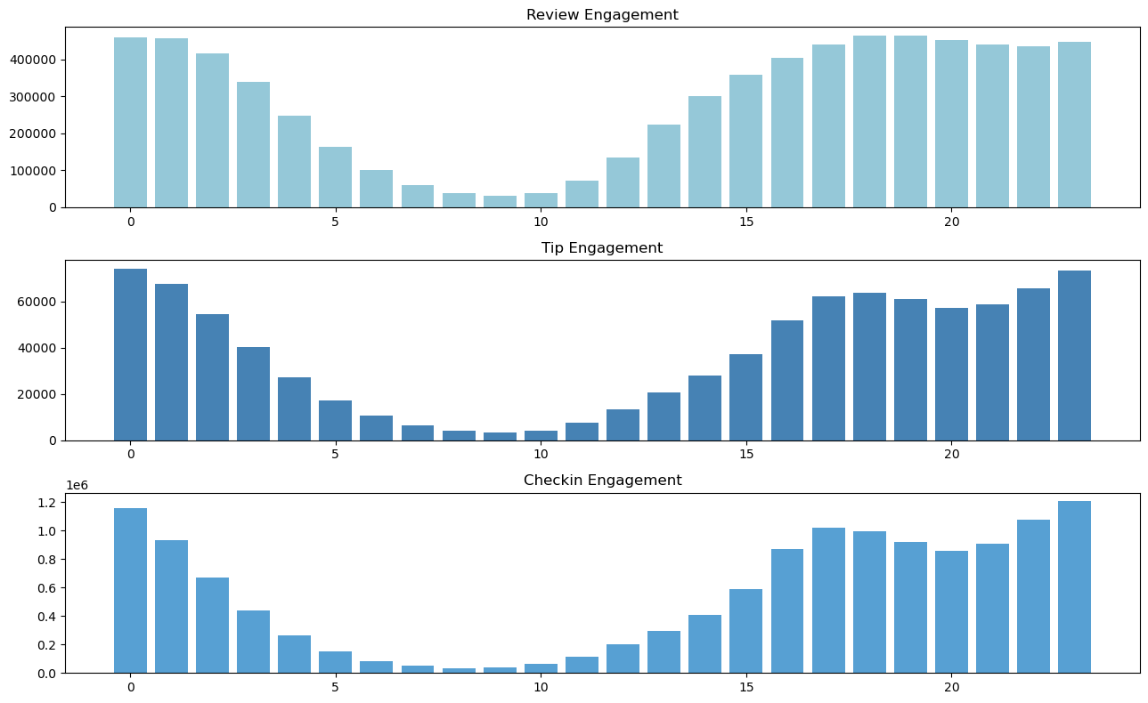
What are the busiest hours for the restaurant?
The busiest hours for restaurants, based on user engagement, span from 4 pm to 1 am.
Knowing the peak hours allows businesses to optimize their staffing levels and resource allocation during these times to ensure efficient operations and quality service delivery.
The concentration of user engagement during the evening and night hours suggests a higher demand for dining out during these times, potentially driven by factors such as work schedules, social gatherings, and leisure activities.

Slide 18
Recommendations
Utilizing insights from the analysis of various metrics such as user engagement, sentiment of reviews, peak hours, and the impact of elite users, businesses can make informed decisions to drive success.
Collaborating with elite users and leveraging their influence can amplify promotional efforts, increase brand awareness, and drive customer acquisition.
Businesses can adjust their operating hours or introduce special promotions to capitalize on the increased demand during peak hours.
Less successful businesses may need to focus on strategies to enhance user engagement over time, such as improving service quality, responding to customer feedback.
Cities with high success scores presents opportunities for restaurant chains to expand or invest further

